Slide 1
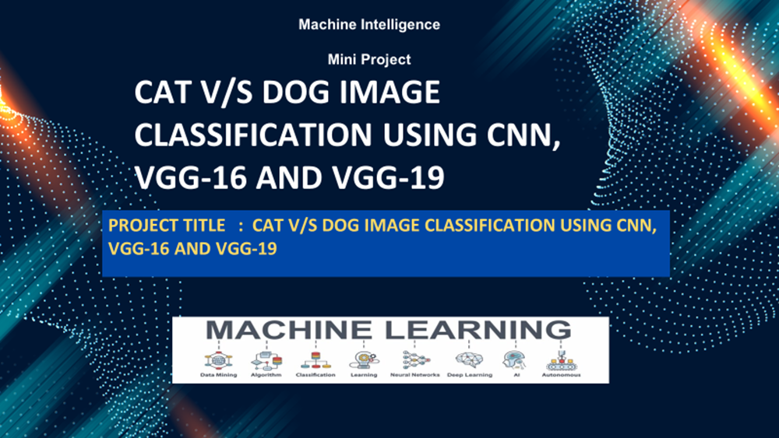
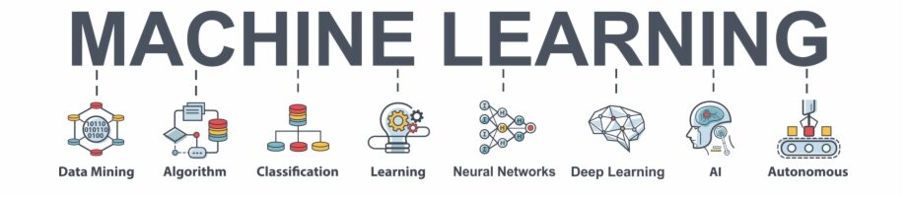
CAT V/S DOG IMAGE CLASSIFICATION USING CNN, VGG-16 AND VGG-19
Machine Intelligence
Mini Project
PROJECT TITLE : CAT V/S DOG IMAGE CLASSIFICATION USING CNN, VGG-16 AND VGG-19

Slide 2
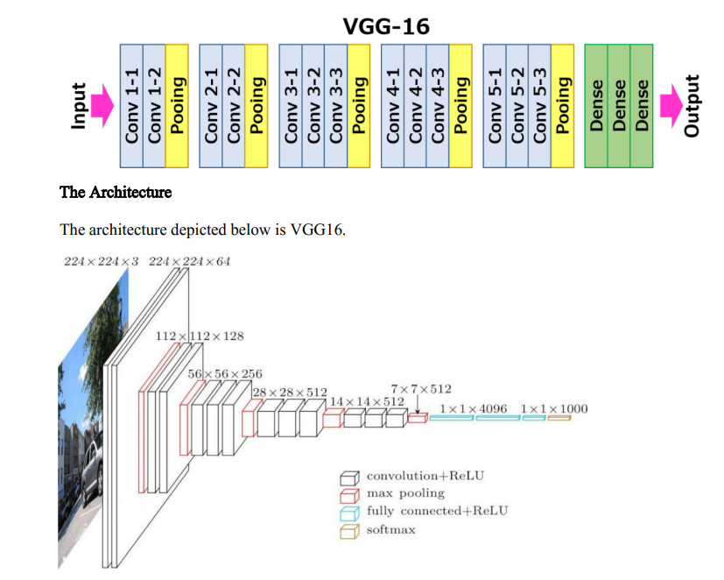
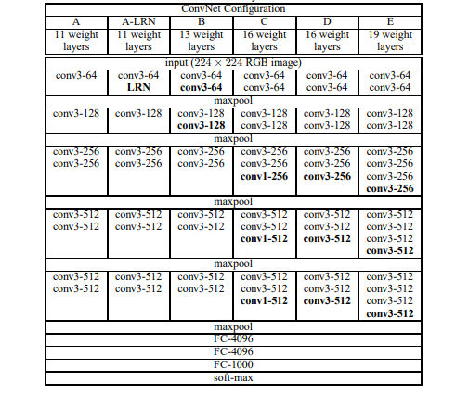
HIGH LEVEL ARCHITECTURE : VGG-16
Notes:
Provide a basic introduction of the project and also an overview of scope it entails.
Set the context.

Slide 3
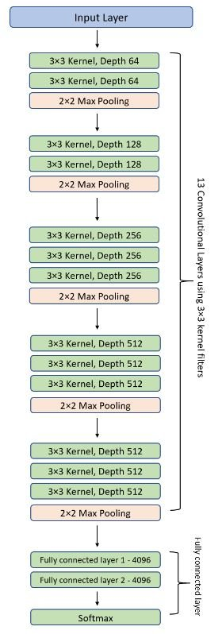
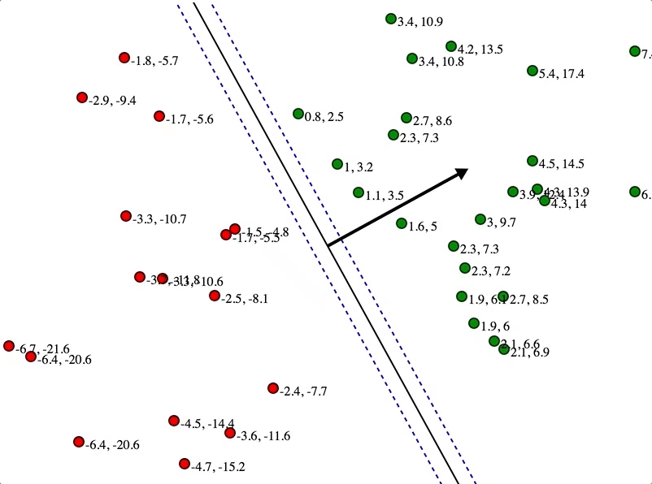
HIGH LEVEL ARCHITECTURE : VGG-16
Notes:
Provide a basic introduction of the project and also an overview of scope it entails.
Set the context.

Slide 4
HIGH LEVEL ARCHITECTURE : VGG-16
COMPLEXITY :
The number of filters that we can use doubles on every step or through every stack of the convolution layer. This is a major principle used to design the architecture of the VGG16 network. One of the crucial downsides of the VGG16 network is that it is a huge network, which means that it takes more time to train its parameters. Because of its depth and number of fully connected layers, the VGG16 model is more than 533MB. This makes implementing a VGG network a time-consuming task.
VGG-16 is a convolutional neural network that is 16 layers deep. You can load a pretrained version of the network trained on more than a million images from the ImageNet database
An improvement over CNN
Karen Simonyan and Andrew Zisserman proposed the idea of the VGG network in 2013 and submitted the actual model based on the idea in the 2014 ImageNet Challenge. They called it VGG after the department of Visual Geometry Group in the University of Oxford that they belonged to.
The idea behind using 3 x 3 filters uniformly is something that makes the VGG stand out. Two consecutive 3 x 3 filters provide for an effective receptive field of 5 x 5. Similarly, three 3 x 3 filters make up for a receptive field of 7 x 7. This way, a combination of multiple 3 x 3 filters can stand in for a receptive area of a larger size.
Notes:
Provide a basic introduction of the project and also an overview of scope it entails.
Set the context.

Slide 5
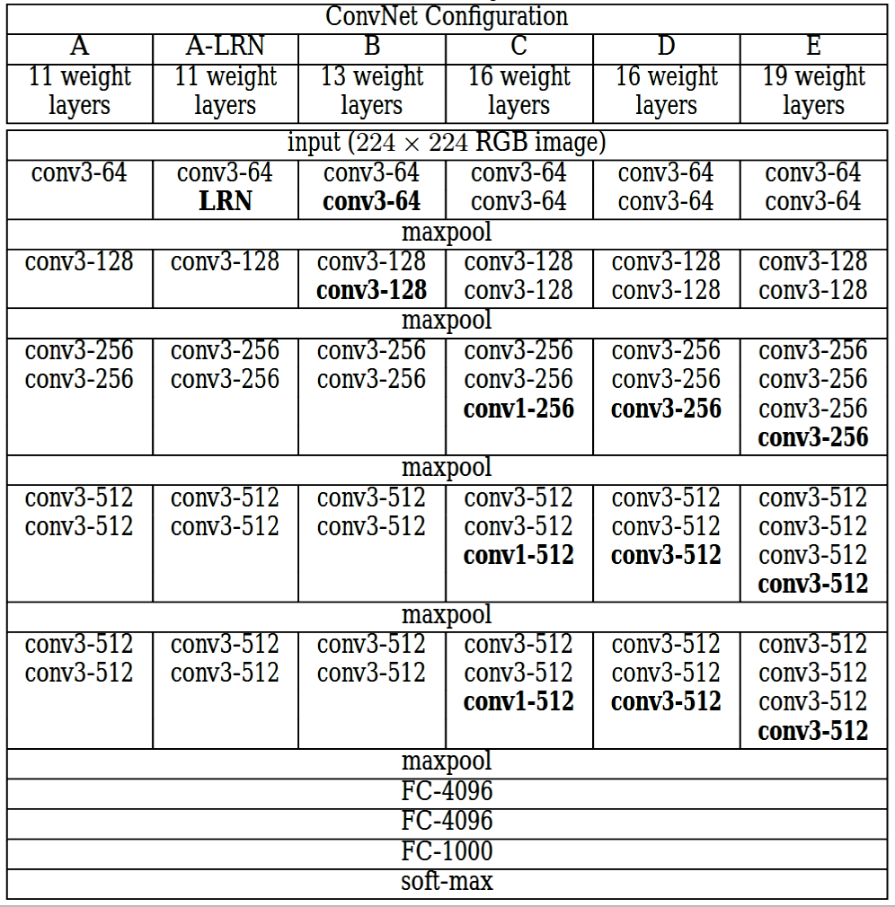
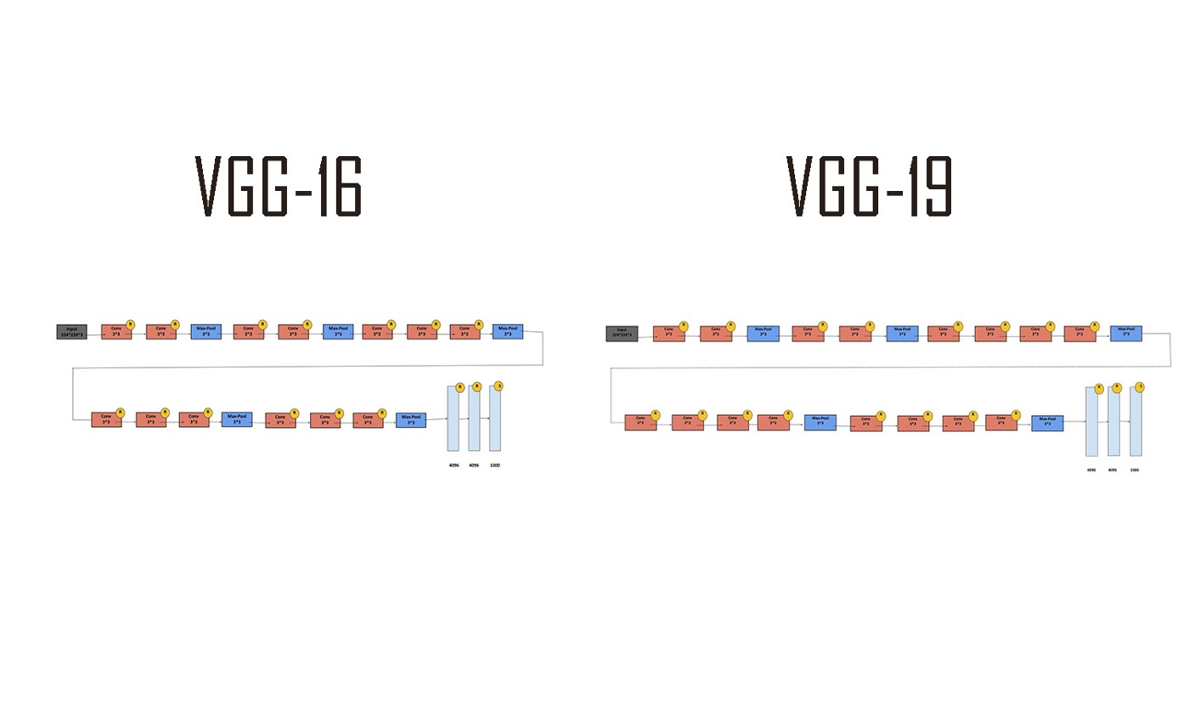
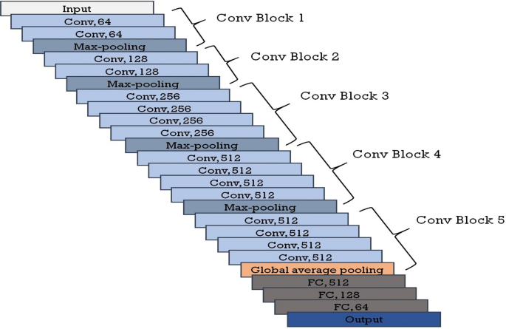
HIGH LEVEL ARCHITECTURE : VGG-19
Notes:
Provide a basic introduction of the project and also an overview of scope it entails.
Set the context.

Slide 6
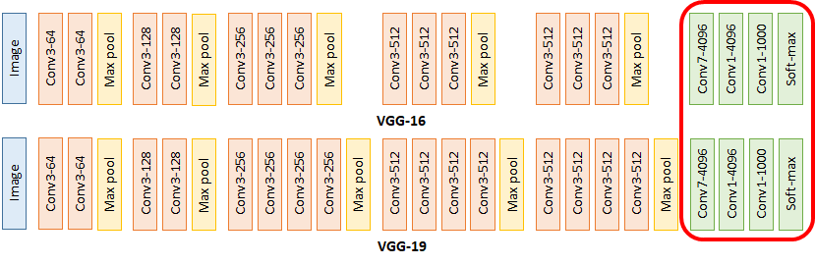
HIGH LEVEL ARCHITECTURE : VGG-19
VGG19 (19 deep neural network) is a variant of VGG model which in short consists of 19 layers (16 convolution layers, 3 Fully connected layer, 5 MaxPool layers and 1 SoftMax layer). There are other variants of VGG like VGG11, VGG16 and others. VGG19 has 19.6 billion FLOPs.
A fixed size of (224 * 224) RGB image was given as input to this network which means that the matrix was of shape (224,224,3).
The only preprocessing that was done is that they subtracted the mean RGB value from each pixel, computed over the whole training set.
Used kernels of (3 * 3) size with a stride size of 1 pixel, this enabled them to cover the whole notion of the image.
spatial padding was used to preserve the spatial resolution of the image.
max pooling was performed over a 2 * 2 pixel windows with sride 2.
this was followed by Rectified linear unit(ReLu) to introduce non-linearity to make the model classify better and to improve computational time as the previous models used tanh or sigmoid functions this proved much better than those.
implemented three fully connected layers from which first two were of size 4096 and after that a layer with 1000 channels for 1000-way ILSVRC classification and the final layer is a softmax function.
Notes:
Provide a basic introduction of the project and also an overview of scope it entails.
Set the context.

Slide 7
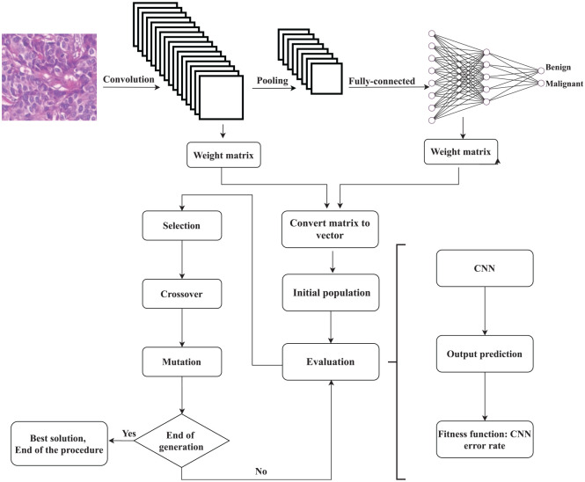
OPTIMIZING CNN/VGG BY GENETIC ALGORITHM – FUTURE WORKS
Errorrate = (FP + FN) / Totalnumberofsamples
Algorithm 2 Optimizing the CNN/VGG through the GA.
Create the CNN/VGG architecture; Generate the initial weights of the model randomly; Store the weights of the model in a matrix; Set the parameters of the GA; Convert the weight matrix to the vector of initial population; while Termination condition is not true do Start the CNN/VGG process; Predict the output using the CNN/VGG; Calculate the fitness function using Error rate equation; Sort individuals based on fitness value; Select individuals for the next generation; Crossover; Mutation; end while
Notes:
Provide a basic introduction of the project and also an overview of scope it entails.
Set the context.

Slide 8
LITERATURE SURVEY : 1
Title of the paper | Year of Publication | Journal/Conference Name | Advantages | Limitations
Image Classification – Cat and Dog Images | 2019 | Tushar Jajodia1, Pankaj Garg2 1Student, Department of Information Technology, Maharaja Agrasen Institute of Technology | The usage of CNN algorithm itself is a big advantage as the accuracy is over 90% even for a smaller dataset. Also, a continuous increase in training set is good enough for the upcoming test accuracy to increase successfully, although the test accuracy saturates over a point of time. | Improvements in accuracy saturated too soon, whereas the testing accuracy went high and high, making learning of model, little inefficient. Also problem of overfitting was still prevalent which needs to addressed, otherwise could lead to problem.
Household Animals Classification Using Deep Learning | 2020 | Lei Lin_ Department of Computer Science Stanford University | Accuracy of more than 95% is achieved with VGG-16. Applying fine-tuning allows us to utilize pre-trained networks to recognize classes they were not originally trained on, reducing the loss to 0.1. | Overfitting is little present but still can be removed by augmentation or batch normalization.
Fooling Network Interpretation in Image Classification | 2019 | Akshayvarun Subramanya* Vipin Pillai* Hamed Pirsiavash University of Maryland, Baltimore County | We successfully design an adversarial patch that does not get highlighted in the interpretation and hence show that popular interpretation algorithms are not highlighting the true cause of the prediction. We introduce adversarial patches (small area, ~8%, with unrestricted perturbations) which fool both the classifier and the interpretation of the resulting category. | Patch is the true cause of the wrong prediction, a reliable interpretation algorithm should definitely highlight the patch region.
Notes:
Provide summary of Phase – 1.
Include the suggestions and improvements made.

Slide 9
LITERATURE SURVEY : 2
Title of the paper | Year of Publication | Journal/Conference Name | Advantages | Limitations
CIFAR-10 IMAGE CLASSIFICATION USING FEATURE ENSEMBLES | 2020 |  | In final model, ensemble methods is consistent and unhelpful perspectives are reduced CNN optimize convolution kernels which map image characteristics to lower dimensionality, allowing for improved memory management while maintaining relevant image information.Author developed and trained FCNN which receives pre-computed features from each image and assigns labels according to internal weights which minimize error across the training dataset. VGG16 initialized with ImageNet weights was trained on the augmented CIFAR-10 training set to optimize network weights. | In general, the inclusion of multiple features sets resulted in improved classification accuracy, and failure in situations which made it difficult for humans to classify as well
Visualizing and Comparing AlexNet and VGG using Deconvolutional Layers | 2016 |  | deeper CNN is better at extracting the discriminant information, which improves the prediction performance. The visualizations of representation spaces constructed from different layers demonstrate the ability of CNN in sorting patterns gradually from low level to high level and show CNN’s ability in gradually extracting discriminant information. | The high layers of VGG-16 are with higher sparsity than AlexNet, which also demonstrates VGG-16 is with better representation ability and removing unrelated information.VGG-16, AlexNet retains more unrelated background information in last convolutional layer, which often disturbs the final prediction.
Image Classification for Dogs and Cats. |  |  | The authors finally achieved the best accuracy 94.00% from an SVM classifier (with RBF kernel and C = 10000) than human crafted feature model | We have two model here human crafted feature accuracy = 67.60% when hsv feature added increase to 71.47% The most possible one is that the Dense-SIFT and color features of dogs and cats are quite similar. Extract more distinctive features, use PCA to reduce dimension or try Deep Neural Network to extract features of images.
Notes:
Provide summary of Phase – 1.
Include the suggestions and improvements made.

Slide 10
LITERATURE SURVEY : 3
Title of the paper | Year of Publication | Journal/Conference Name | Advantages | Limitations
Explore Visual Concept Formation for Image Classification | 2021 | 8 th International Conference on Machine Learning, PMLR 139, 2021. | The models based on all selected backbones will be trained on cifar10, STL10 and flower17, and the proposed LSOVCF will be compared with the strategy that based on one-hot code and CE-Loss. On the cifar10 dataset, the accuracy of all backbones in the proposed strategy is improved compared with the previous algorithms, especially ResNet and ShuffleNet v2. | The size of output space is set to 256, which is too small to hold many concepts. And one dimension is not enough too, considering the 1000 categories of ImageNet, at least 10000 neurons is needed in the last linear layer of ConvNet.
Transfer learning using VGG-16 with Deep Convolutional Neural Network for Classifying Images | 2019 |  | Cnn and vgg are used . convolutional neural network gives validation accuracy of 72.40 %. We fine tuned this model with image augmentation and achieved accuracy of 79.20 %. Lastly, we leverage the use of one of the pretrained models (VGG-16) trained on huge dataset of images and fine-tuned with image augmentation to achieve accuracy of 95.40 % | The model built by using convolutional neural network in Ⅰ is trained on small dataset of images; therefore, it didn’t predict well and ended up overfitting after 3 epochs
Evolutionary algorithms deceive humans and machines at image classification: an extended proof of concept on two scenarios | 2020 |  | Vgg are used. Fitness functions are used in the dataset ., VGG-16 outputs the following class probabilities: 0.999 bird, 0.954 dog, 0.953 dog; 0.999 deer, 0.951 ship, 0.954 ship. | Although algorithms successfully managed to deceive the neural network, while producing adversarial images similar to the original, a closer comparison of the original and modified images reveals the noisiness of the evolved images. This noisiness is noticeable here as CIFAR-10 images have a low resolution.
Notes:
Provide summary of Phase – 1.
Include the suggestions and improvements made.

Slide 11
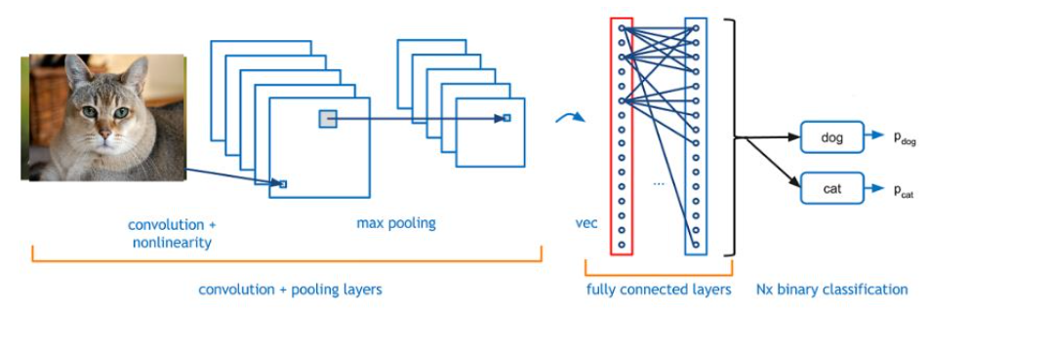
PROPOSED APPROACH
the image size to be 128 X 128 , with a batch size of 512 and classmode mode as binary.
Then with the help of keras package we create a CNN, VGG-16 and VGG-19 models according to the architecture. The layers are added accordingly. Proceeding this we compile the model using model.compile() with an optimizer like adam. Further the model is trained using model.fit() function with all the generators and number of epochs as the parameters. Number of epochs is restricted to 30.
Succeeding, we evaluate our model for accuracy and loss using evaluate_generator() and then plot the confusion matrix.
Lastly , we plot the accuracy and loss graph and take 10 random images of cats and dogs and use our model for testing. Hence, this is the approach and conclude here.
Methodology will include the steps to be followed to achieve the objective of the project during the project development and the High level architecture diagram (as discussed until now)
We have used a dataset of 25,000 images with cats and dogs being 12500 images each. We convert our image dataset to dataframe of images and labels. Then these images are split for training and testing by applying 80:20 train test split. So, 5000 images go for testing and 20000 goes for training. Following this, we create a test and val generator for the above split by taking
Notes:
Provide summary of Phase – 1.
Include the suggestions and improvements made.

Slide 12
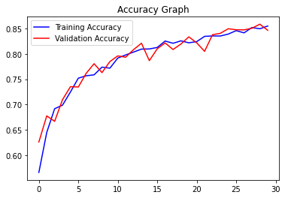
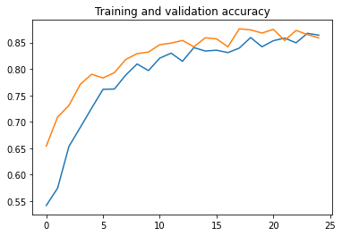
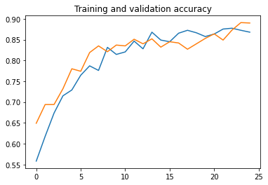
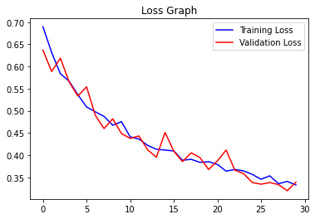
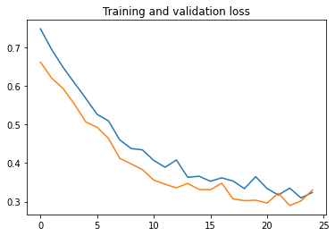
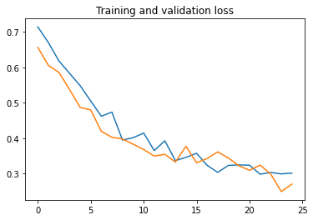
RESULTS AND DISCUSSION
CNN - 30 Epochs
VGG-16 - 25 Epochs
VGG-19 - 25 Epochs
Train acc = 85.50% Train Loss = 33.2%
Val acc = 84.66% Val Loss = 33.9%
Train acc = 86.40% Train Loss = 32.3%
Val acc = 85.90% Val Loss = 33.0%
Train acc = 86.80% Train Loss = 30.1%
Val acc = 89.00% Val Loss = 27.0%
Notes:
Provide summary of Phase – 1.
Include the suggestions and improvements made.

Slide 13

REFERENCES
Transfer_learning_using_VGG-16_with_Deep_Convoluti OCTOBER 2019
Explore Visual Concept Formation for Image Classification
Subramanya_Fooling_Network_Interpretation_in_Image_Classification_ICCV_2019_paper 2019
Household Animals Classification Using Deep Learning
Image Classification – Cat and Dog Images 2019
Image Classification – Cat and Dog Images 2016
Evolutionary algorithms deceive humans and
machines at image classification: an extended
proof of concept on two scenario 2020
Deep learning for image classification on very small datasets using transfer learning 2019
Deep learning for image classification on very small datasets using transfer learning 2020
Notes:
Provide summary of Phase – 1.
Include the suggestions and improvements made.

Slide 14

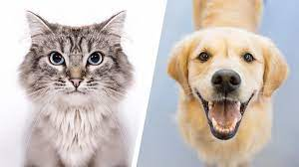

Thank You!!!
- S M SUTHARSAN RAJ

